Slide 1
Indeed Web-scraping Interview Cracker
Semester: Spring 2018 Professor: Wajahat Gilani
Naveen Dayakar Velpur
Amirtha Sridharan
Abhinaya Krishnamachari
Ankita Hunsur Ashok
Karan Ramdas

Slide 2
Project Goal
Web-scraping Indeed to find list of jobs according to given inputs.
Extract required programming languages from each job description.
Finding the top required skills for all the jobs listed for that particular job designation, and the location.
Send the skills as input to website (JavaTPoint)
Extract the interview questions and answers for all the top skills.
Append all the Q&A to a single CSV file.

Slide 3
Indeed Web-scraping
Scraping done from Indeed website using Beautifulsoup module
Extract text from job descriptions and break down sentences into words.
Use NLTK (Natural Language Tool Kit) based Stopwords package to filter out Stop words like ‘the’ and other unimportant words
Obtain words that are programming skills
Count the number of times the skills appear in each job description
Collect the top skills often appearing in all jobs put together.
Get Q&A for those top skills.

Slide 4
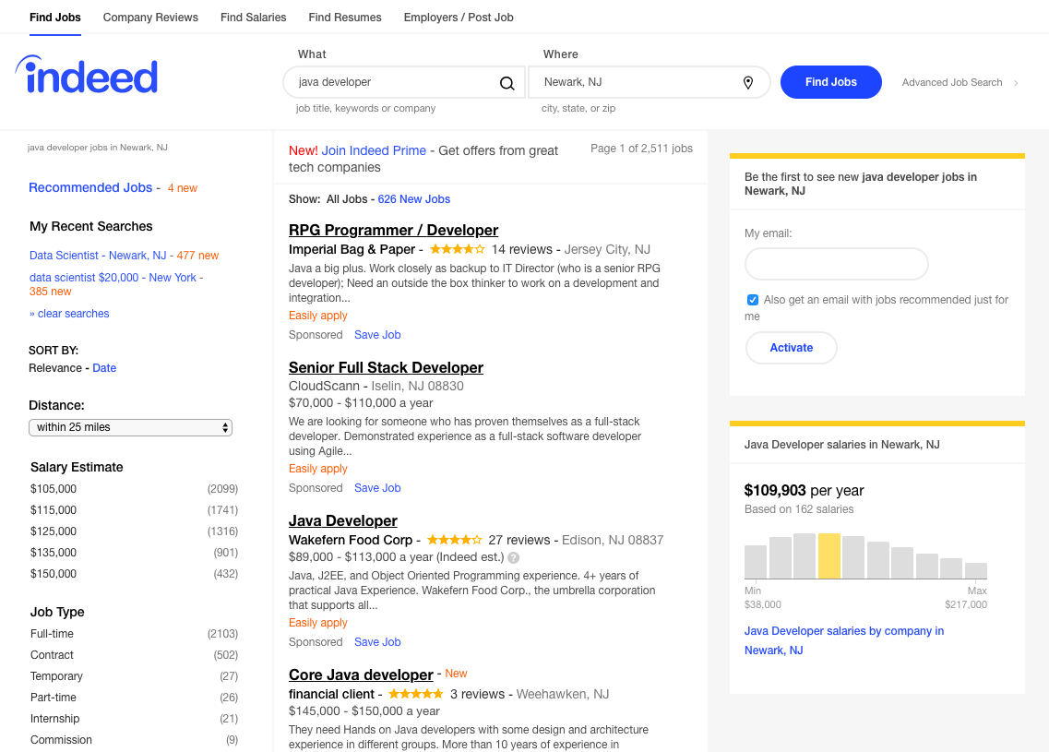
INDEED JOB SEARCH
Inputs:
Job Type
City, State
List of jobs appear for the job description and specified location.
Each job description is read, and the required skills are collected.
Mapping using dictionary to rule- out unwanted words. Dict contains list of programming lang.
Most frequently required skills from all jobs are observed.

Slide 5
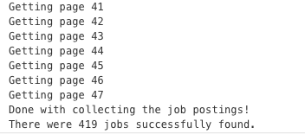
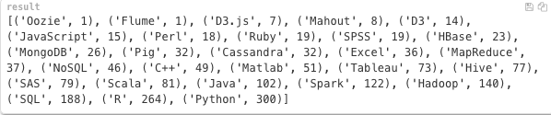
Getting the top required skills
List of jobs collected from all the pages.
Looks for required skills in Job Description of each job posted.
Number of times the skills appear in all the jobs are counted.
List is sorted in ascending order.

Slide 6
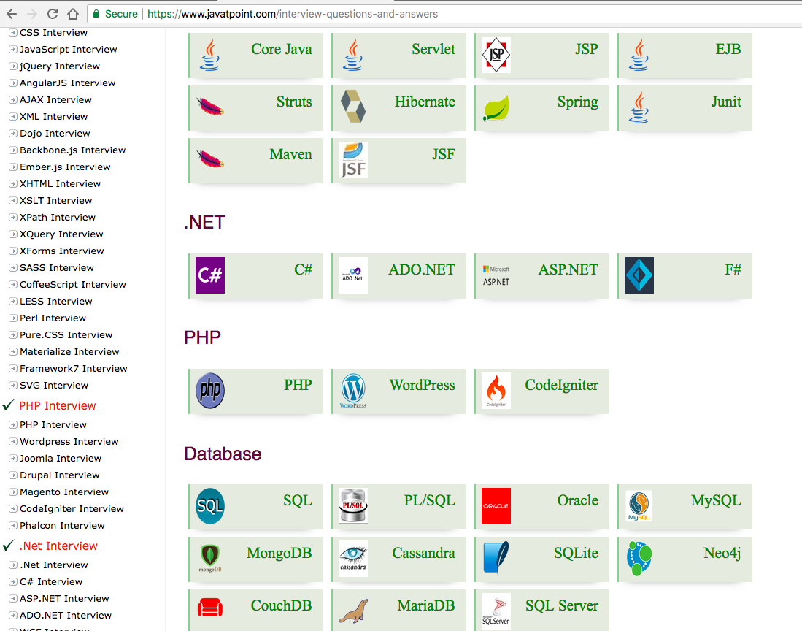
JavaTpoint Website
Website has list of skills (as seen in the picture).
The website gives collection of Interview Questions based on the programming language.
The code extracts the questions and answers, appends it into csv.
Questions and answers are retrieved for most frequent skills.

Slide 7
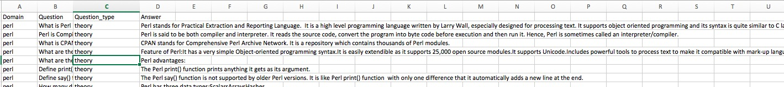
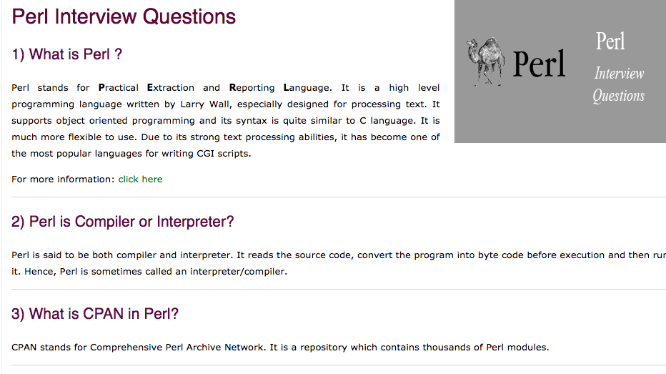
OUTPUT FILE(Above):
The output csv file with interview questions.
Website(Left):
The interview questions and answers in the website.

Slide 8
FUTURE WORK
Find a better website that has Q&A for all skills, the current website used has less number of skills.
Extract list of company-wise job postings from indeed, and
Get interview Q&A based on companies with most number of job postings.

